Slide 1

Self-Supervised Learning
Exercise 1
Refael Zanzuri
Michael Lugassi
ML

Slide 2
Introduction
Rotation Method Explanation
What is the method
Pros & Cons
Evaluation Self-Supervised model compared to supervised models
Introducing 3 experiment models
Experiment Results
Summary and Conclusions

Slide 3
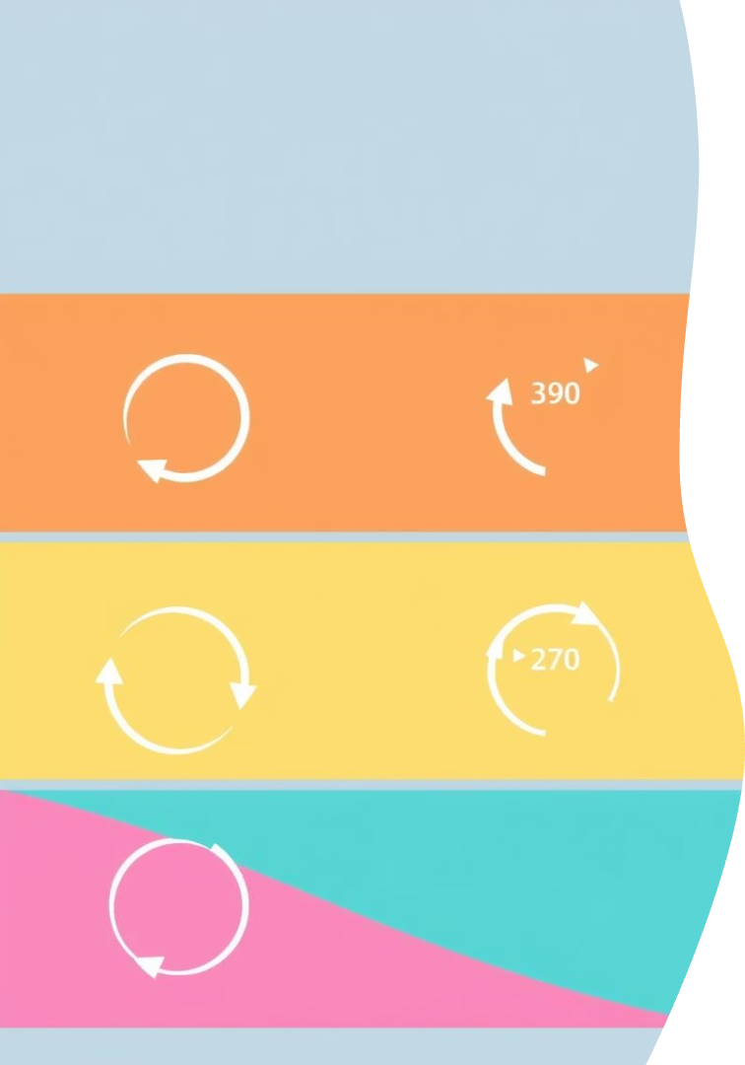
Rotation Method Explanation
Step 1
Rotate images to 0°, 90°, 180°, 270°
Step 2
Model predicts rotation angle for each image
Step 3
Enhances model's feature representation
Step 4
Artificially expands dataset size

Slide 4
Rotation Method - Pros & Cons
Advantage:
Learns meaningful visual features without labeled data
Encourages the model to understand object in images
Simple to implement and computationally efficient
Limitations:
May not generalize well to all downstream tasks
Less effective on symmetric images or domains where rotation is meaningless (e.g., text)

Slide 5

Model 1: Supervised - Full Data Training
All CIFAR-10 dataset
Resnet18 + FC - 10 classes
512 Epochs
Batch Size 128
Learning Rate 0.001

Slide 6
Model 2: Supervised - Small Data Training
600 CIFAR-10 images (60 per class, 10 classes)
Resnet18 + FC - 10 classes
512 Epochs
Batch Size 128
Learning Rate 0.001

Slide 7
Model 3: Self-Supervised - Small Data Training
Phase 1:
CIFAR-10 ×4 (rotations: 0°, 90°, 180°, 270°)
Resnet18 + FC (4 classes)
512 Epochs
Batch Size 128
Learning Rate 0.001
Phase 2:
600 CIFAR-10 images (60 per class, 10 classes)
Resnet18 + FC (10 classes)
1024 Epochs
Batch Size 128
Learning Rate 0.001

Slide 8
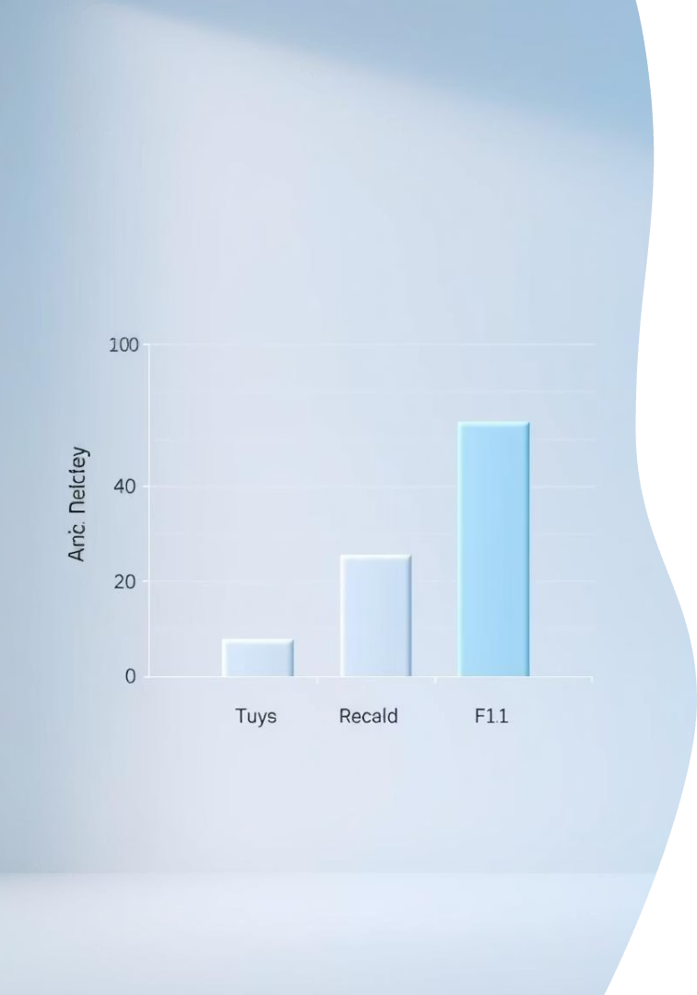
Experiment Results: Model Performance Comparison
86.36%
42.13%
Supervised - Full Data
Supervised - Small Data
57.64%
Self-Supervised - Small Data
Rotation method closes gap with full data results.
Significant improvement over partial data only.

Slide 9

Summary and Conclusions
Self-supervised Rotation improves model accuracy
Efficient use of unlabeled data
Simple and practical solution for limited labeled data
The rotation method enables model training with reduced labeling costs and needs - with significant results

